Slide 1
Fine-Grained Visual Categorization
With Fine-Tuned Segmentation (ICIP 2015)
Lingyun Li¹, Yanqing Guo¹,
Lingxi Xie², Xiangwei Kong¹, Qi Tian³
¹ Dept. of Digital Image Processing, Dalian University of Technology
² Dept. of Computer Science and Technology, Tsinghua University
³ Dept. of Computer Science, University of Texas at San Antonio

Slide 2
Outline
Introduction
The Part-Based Model
Fine-Tuned Segmentation
Experimental Results
Conclusions

Slide 3
Outline
Introduction
The Part-Based Model
Fine-Tuned Segmentation
Experimental Results
Conclusions

Slide 4

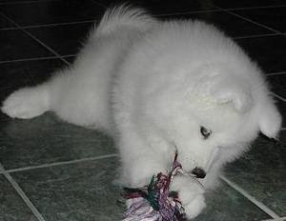
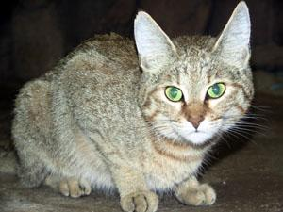
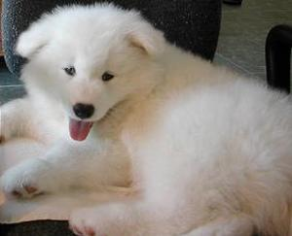
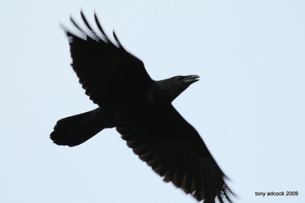
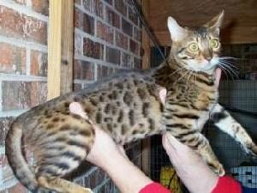
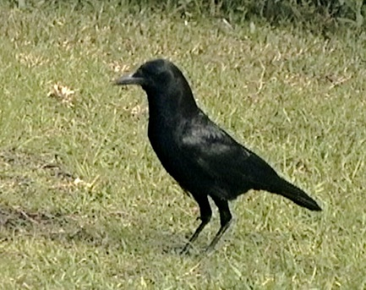
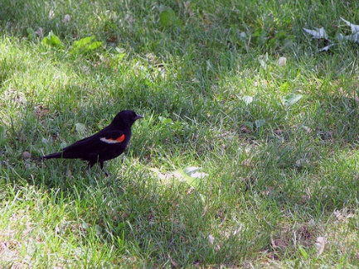
Image Classification
A basic task towards image understanding
  General vs. Fine-Grained
Part is Important !

Slide 5
Outline
Introduction
The Part-Based Model
Fine-Tuned Segmentation
Experimental Results
Conclusions

Slide 6
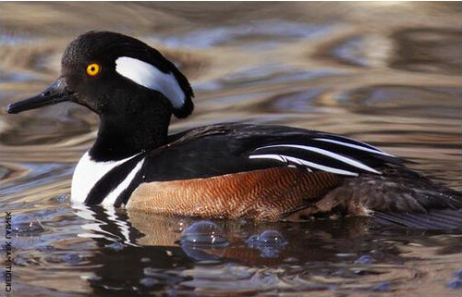
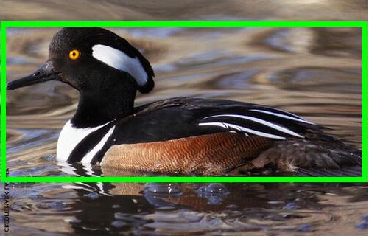

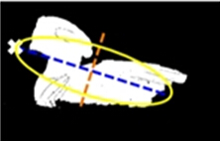
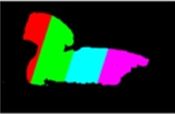
Raw Image
Recognition
of a bird
Segmentation of the image
Assumption
of an ellipse
Alignment

Slide 7
Outline
Introduction
The Part-Based Model
Fine-Tuned Segmentation
Experimental Results
Conclusions

Slide 8


Motivation
1
1
Segmentation
Alignment
2
2
3
3
4
Over-segmentation
Ambiguity

Slide 9
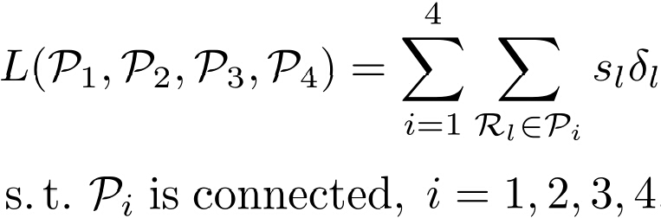
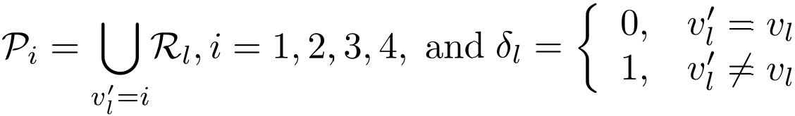
Part Mergence
Discovering Fine-Tuned Parts
  Loss Function
Where

Slide 10

Part Mergence
Discovering Fine-Tuned Parts
  Fine-tuned parts

Slide 11

Part Mergence
1
Seeding
2
3
4

Slide 12
Part Mergence
1
Seeding
2
3
4

Slide 13
Part Mergence
1
Seeding
2
3
4

Slide 14
Part Mergence
1
Seeding
2
3
4

Slide 15
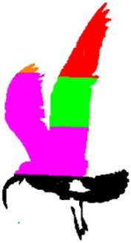
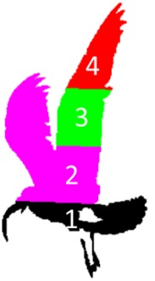
Part Mergence
1
1
2
2
3
3
4
4

Slide 16






Part Mergence
Constructing Mid-level Parts
  Bruteforce Search
  1. Initialization. Start from the refined four parts
  . .
  2. Searching. Enumerate all parts , and construct , where m, n are the indices of two neighboring parts.
  3. Construction. Organize the combined part meanwhile discarding both and (rest parts are remain unchanged).

Slide 17
Outline
Introduction
The Part-Based Model
Fine-Tuned Segmentation
Experimental Results
Conclusions

Slide 18
Dataset & Features
Caltech-UCSD Bird-200-2011 Dataset
  11788 Images
  200 Bird Categories
  Accuracy by Category (fixed training/testing split)
  Features
  Descriptors: LCS and Max-SIFT
  Four Types:
  LCS (feature using LCS descriptor)
  MSIFT (feature using Max-SIFT descriptor)
  Fused (Concatenation with LCS and MSIFT)
  Deep Conv-net (CNN feature)

Slide 19
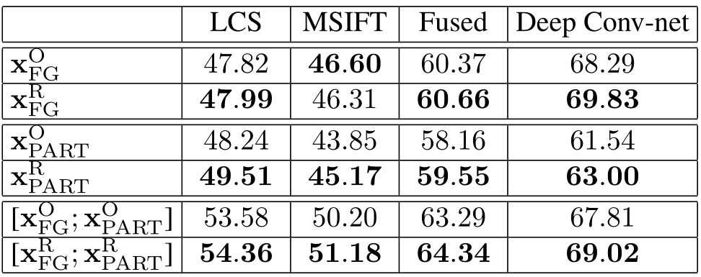
Part Mergence

Slide 20
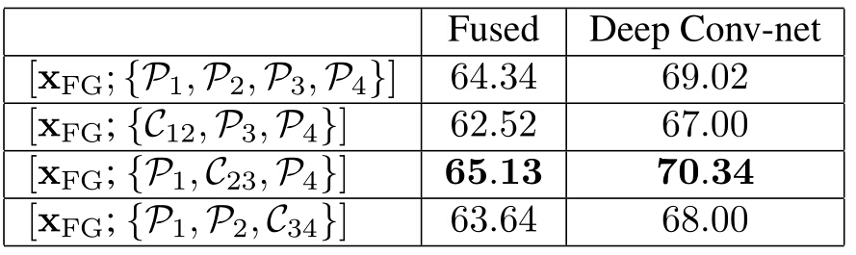
Part Mergence

Slide 21
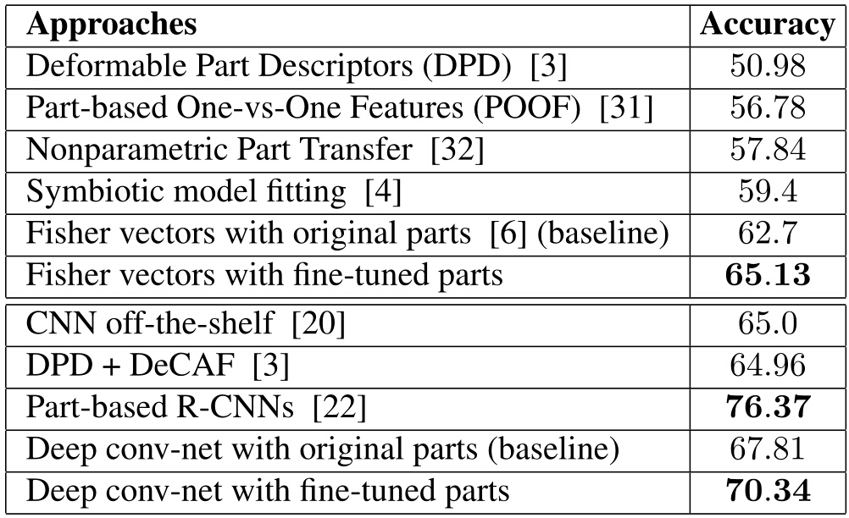
Comparison

Slide 22
Summarization
All Components Help!
The Improvement comes from The Proposed Fine-Tuned Segmentation.
Performance is competitive with previous arts.

Slide 23
Outline
Introduction
The Part-Based Model
Fine-Tuned Segmentation
Experimental Results
Conclusions

Slide 24
Conclusions
Main Contribution
  An evidence on the benefit of fine-tuned segmentation for fine-grained visual classification
Future Work
  Generalize our work to other part detectors
  Generalize our work to other fine-grained datasets

Slide 25
Thank you!
Questions please?

Slide 26
Questions
DPM(Deformable Part Model)
  Segmentation
  Detection
Annotation propagation
  HOG + K-NN
  Pose Graph

